Slide 1
Design Concepts and Principles
Instructor: Mehroze Khan

Slide 2
Design Principles
Design principles are guidelines for decomposing a system’s required functionality and behavior into modules
The principles identify the criteria
for decomposing a system
deciding what information to provide (and what to conceal) in the resulting modules
Six dominant principles (general):
Modularity
Interfaces
Information hiding
Incremental development
Abstraction
Generality

Slide 3
Modularity
Modularity is the principle of keeping the unrelated aspects of a system separate from each other,
each aspect can be studied in isolation (also called separation of concerns)
If the principle is applied well, each resulting module will have a single purpose and will be relatively independent of the others
Each module will be easy to understand and develop
Easier to locate faults
because there are fewer suspect modules per fault
Easier to change the system
because a change to one module affects relatively few other modules
To determine how well a design separates concerns, we use two concepts that measure module independence: coupling and cohesion
Notes:
Concerns can be functions, data, features, tasks, qualities, or any aspect of the requirements or design that we want to define or understand in more detail.

Slide 4
Modularity: Coupling
Two modules are tightly coupled when they depend a great deal on each other
Loosely coupled modules have some dependence, but their interconnections are weak
Uncoupled modules have no interconnections at all; they are completely unrelated

Slide 5
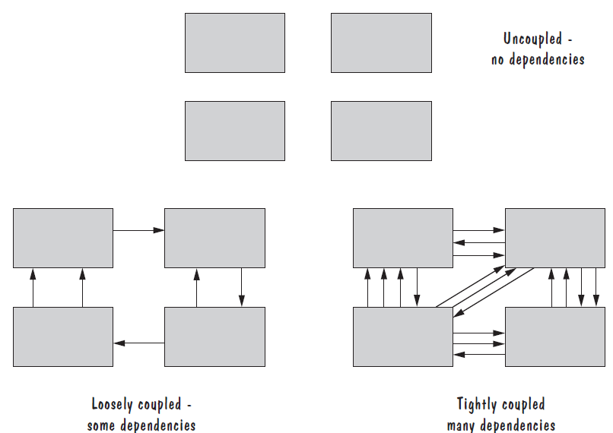
Modularity: Coupling

Slide 6
Modularity: Coupling
There are many ways that modules can depend on each other:
The references made from one module to another
The amount of data passed from one module to another
The amount of control that one module has over the other
Coupling can be measured along a spectrum of dependence, ranging from complete dependance to complete independence
Notes:
The references made from one module to another: Module A may invoke operations in module B, so module A depends on module B for completion of its function or process.
The amount of data passed from one module to another: Module A may pass a parameter, the contents of an array, or a block of data to module B.
The amount of control that one module has over the other: Module A may pass a control flag to module B. The value of the flag tells module B the state of some resource or subsystem, which procedure to invoke, or whether to invoke a procedure at all.

Slide 7
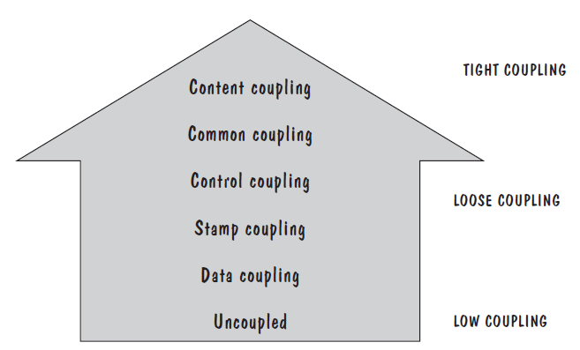
Modularity: Types of Coupling
Content coupling
Common coupling
Control coupling
Stamp coupling
Data coupling
High coupling is not desired

Slide 8
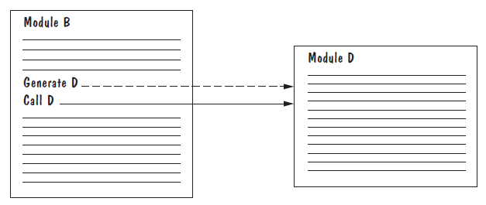
Modularity: Content Coupling
One module modifies another. The modified module is completely dependent on the modifying one
One class modifies the content of another class. For example, in C++, friend classes can access each other’s private members.
Content coupling might occur when one module is imported into another module, modifies the code of another module, or branches into the middle of another module

Slide 9
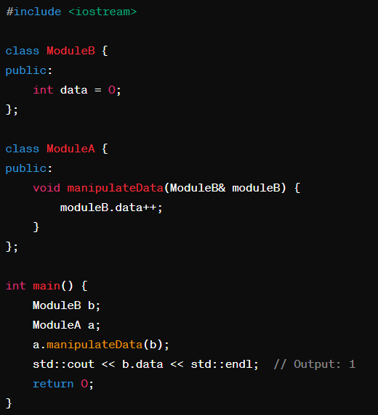
Modularity: Content Coupling
Consider a scenario where Module A directly accesses the variables of Module B and manipulates them. If Module B's internal structure or variable names change, Module A would need to be updated accordingly.

Slide 10
Modularity: Common Coupling
We can reduce the amount of coupling somewhat by organizing our design so that data are accessible from a common data store.
Dependence still exists; making a change to the common data means that, to evaluate the effect of the change, we must look at all modules that access those data.
With common coupling, it can be difficult to determine which module is responsible for having set a variable to a particular value.

Slide 11
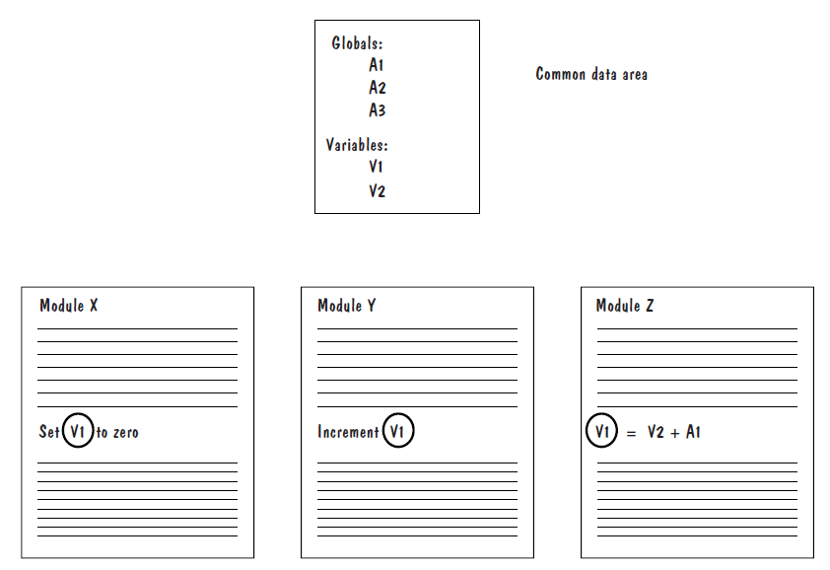
Modularity: Common Coupling

Slide 12
Modularity: Control Coupling
When one module passes parameters or a return code to control the behavior of another module
It is impossible for the controlled module to function without some direction from the controlling module
Limit each module to be responsible for only one function or one activity.
Restriction minimizes the amount of information that is passed to a controlled module
It simplifies the module’s interface to a fixed and recognizable set of parameters and return values.

Slide 13
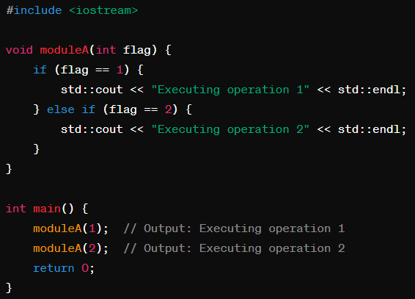
Modularity: Control Coupling

Slide 14
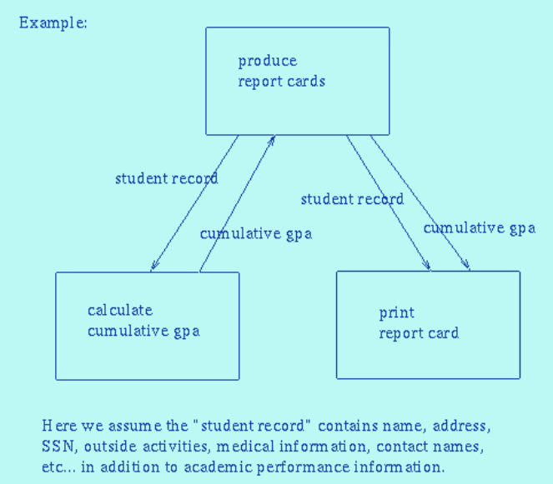
Modularity: Stamp Coupling
Stamp coupling occurs when modules exchange complex data structures, typically large parameters or data objects, instead of passing only the necessary information.
Stamp coupling represents a more complex interface between modules, because the modules have to agree on the data’s format and organization

Slide 15
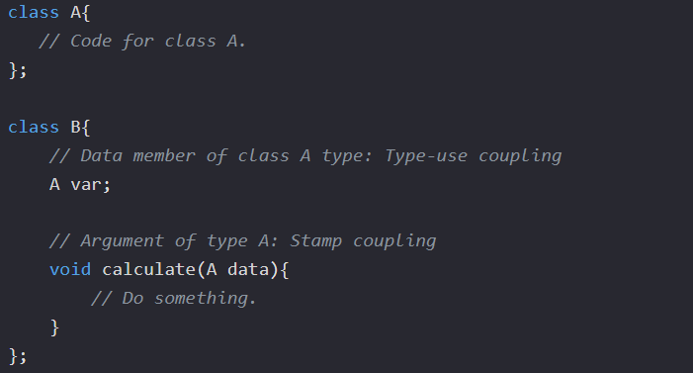
Modularity: Stamp Coupling
When the signature of one of Class B's functions has class A as its argument or return type.

Slide 16
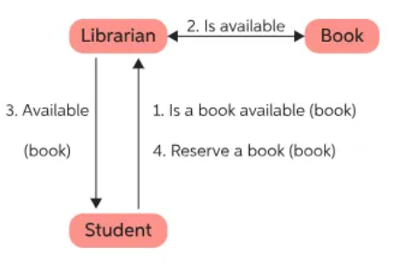
Modularity: Data Coupling
If only data values, and not structured data, are passed, then the modules are connected by data coupling
Data coupling is simpler and less likely to be affected by changes in data representation.
Easiest to trace data through and to make changes to data coupled modules.

Slide 17
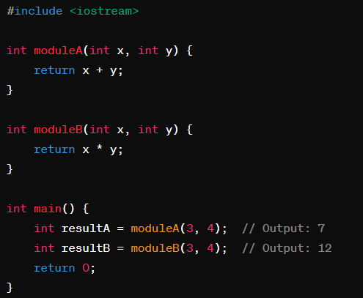
Modularity: Data Coupling

Slide 18
Modularity: Cohesion
Cohesion refers to the dependence within and among a module’s internal elements (e.g., data, functions, internal modules)
The more cohesive a module, the more closely related its pieces are

Slide 19
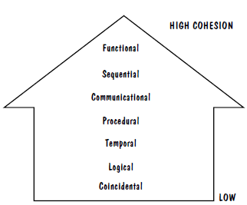
Modularity: Types of Cohesion
Coincidental cohesion
Logical cohesion
Temporal cohesion
Procedural cohesion
Communicational cohesion
Functional cohesion
Sequential cohesion
Low cohesion is not desired

Slide 20
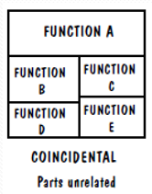
Modularity: Coincidental Cohesion
The worst degree of cohesion, coincidental, is found in a module whose parts are unrelated to one another
This is often considered the weakest form of cohesion because it doesn't reflect a logical design principle.
Unrelated functions, processes, or data are combined in the same module for reasons of convenience

Slide 21
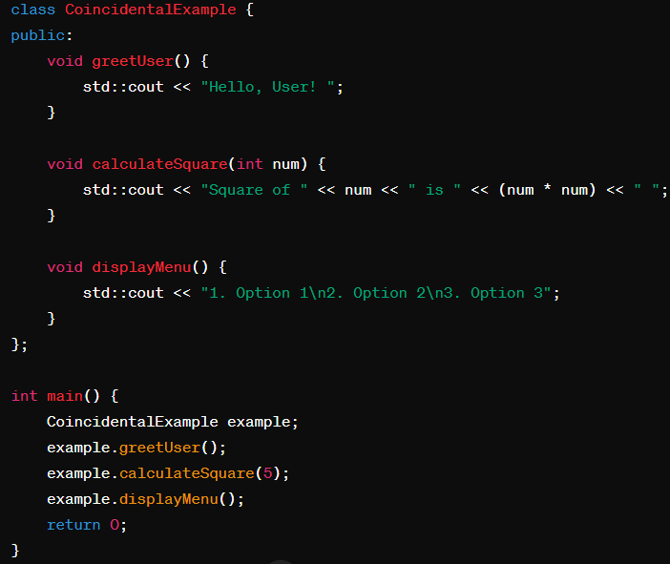
Modularity: Coincidental Cohesion

Slide 22
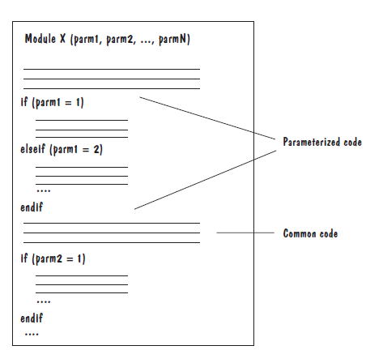
Modularity: Logical Cohesion
A module has logical cohesion if its parts are related only by the logic structure of its code

Slide 23
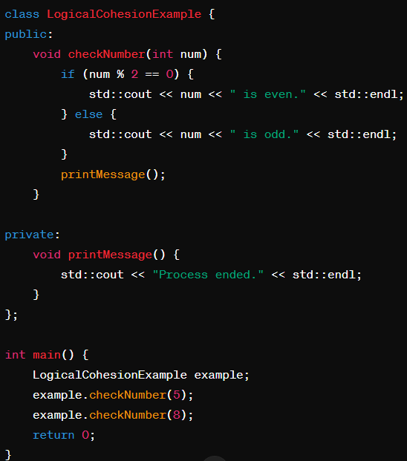
Modularity: Logical Cohesion

Slide 24
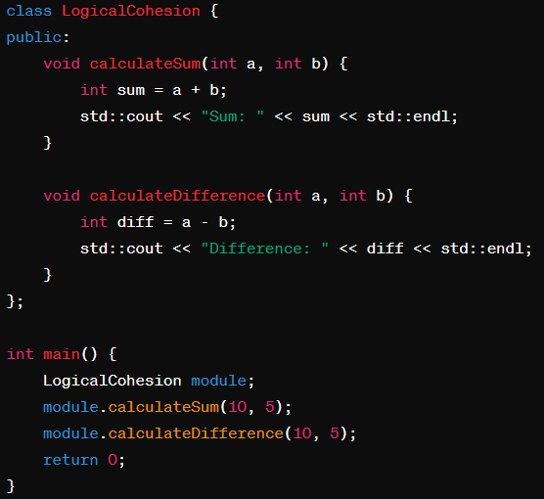
Modularity: Logical Cohesion

Slide 25
Modularity: Temporal Cohesion
Elements of component are related by timing.
Temporal cohesion occurs when elements within a module are executed sequentially due to their temporal relationship.
These elements may not be logically related but are performed together because they happen to be executed in sequence.

Slide 26
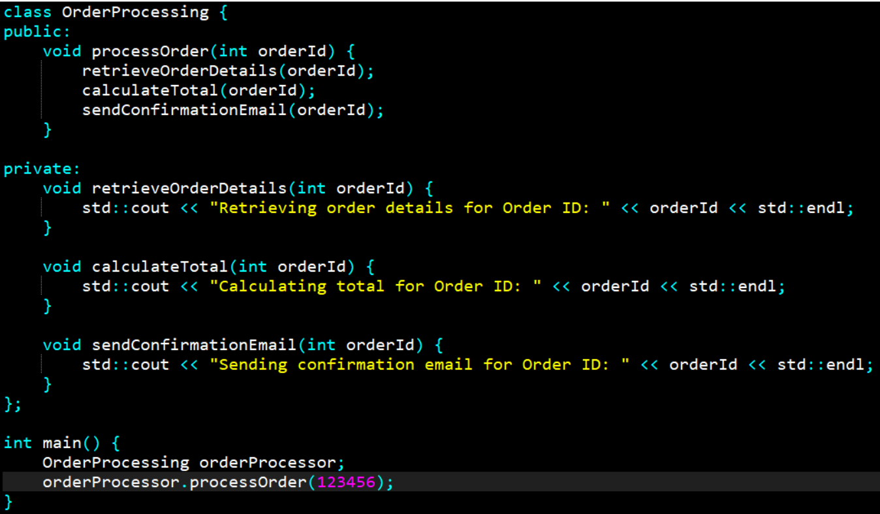
Modularity: Temporal Cohesion

Slide 27
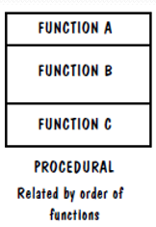
Modularity: Procedural Cohesion
Procedural cohesion occurs when elements within a module are grouped together because they are required to perform a specific task or procedure.
The elements work together to accomplish a common procedural goal.

Slide 28
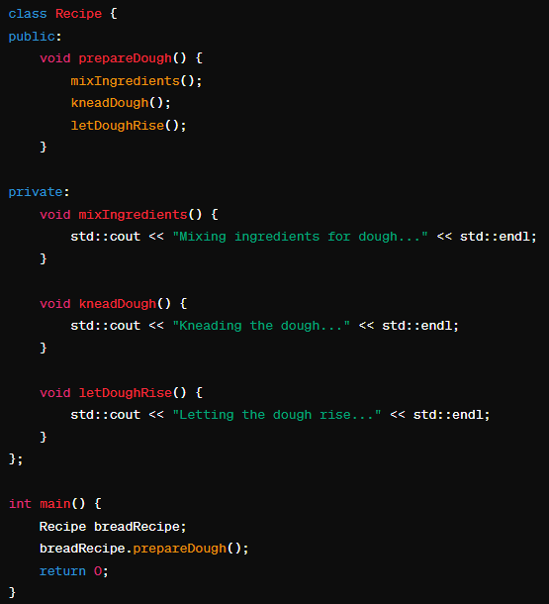
Modularity: Procedural Cohesion

Slide 29
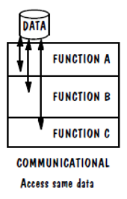
Modularity: Communicational Cohesion
Communicational cohesion occurs when elements within a module are grouped together because they operate on the same data or input/output.
The elements communicate with each other through shared data or parameters.

Slide 30
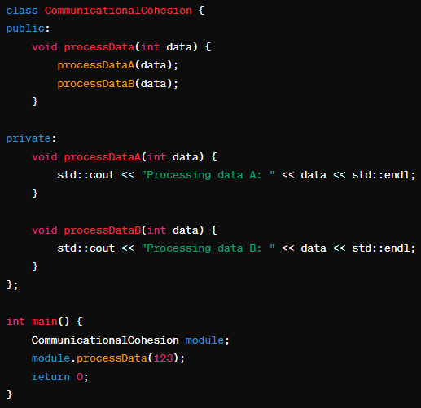
Modularity: Communicational Cohesion

Slide 31
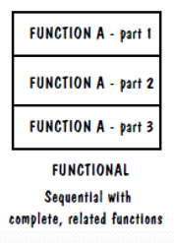
Modularity: Functional Cohesion
All elements essential to a single function are contained in one module, and all of that module’s elements are essential to the performance of that function
A functionally cohesive module performs only the function for which it is designed, and nothing else

Slide 32
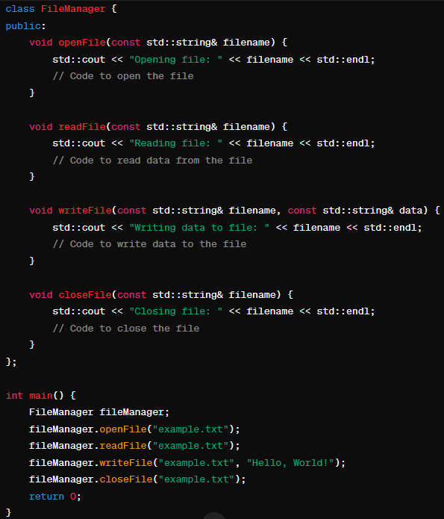
Modularity: Functional Cohesion

Slide 33
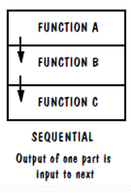
Modularity: Sequential Cohesion
Sequential cohesion is when parts of a module are grouped because the output from one part is the input to another part like an assembly line

Slide 34
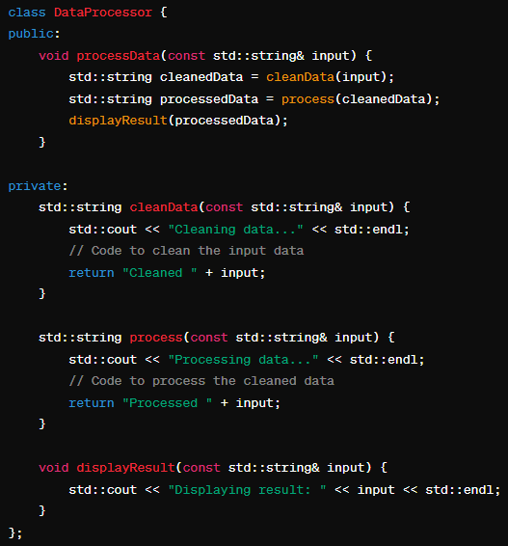
Modularity: Sequential Cohesion

Slide 35
Modularity: Informational Cohesion
Elements within a module are grouped together because they are related by providing information about a specific topic, entity, or concept.
In other words, the elements within the module are responsible for gathering, processing, and presenting information about a common subject.
The design goal is the same: to put data, actions, or objects together only when they have one common, sensible purpose.
For example, we say that an OO design component is cohesive if all of the attributes, methods, and action are strongly interdependent and essential to the object

Slide 36
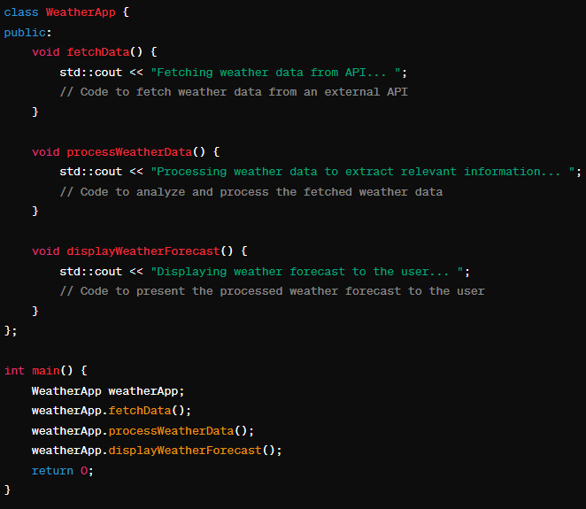
Modularity: Informational Cohesion

Slide 37
Interfaces
An interface defines what services the software unit provides to the rest of the system, and how other units can access those services
For example, the interface to an object is the collection of the object’s public operations and the operations’ signatures, which specify each operation’s name, parameters, and possible return values
An interface must also define what the unit requires, in terms of services or assumptions, for it to work correctly
A software unit’s interface describes what the unit requires of its environment, as well as what it provides to its environment

Slide 38
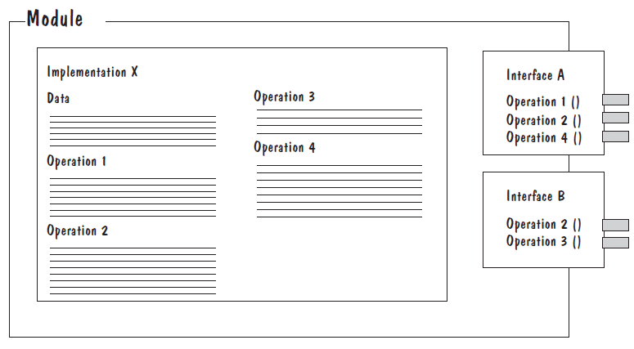
Interfaces
A software unit may have several interfaces that make different demands on its environment or that offer different levels of service

Slide 39
Interfaces
The specification of a software unit’s interface describes the externally visible properties of the software unit
An interface specification should communicate to other system developers everything that they need to know to use our software unit correctly
Purpose
Preconditions (assumptions)
values of input parameters, states of global resources, or presence of program libraries or other software units
Protocols
order in which access functions should be invoked, or the pattern in which two components should exchange messages
Postconditions (visible effects)
return values, raised exceptions, and changes to shared variables
Quality attributes
performance, reliability
Notes:
Purpose: We document the functionality of each access function, in enough detail that other developers can identify which access functions fit their needs
Preconditions: We list all assumptions, called preconditions, that our unit makes about its usage (e.g., values of input parameters, states of global resources, or presence of program libraries or other software units)
Protocols: We include protocol information about the order in which access functions should be invoked, or the pattern in which two components should exchange messages. For example, a calling module may need to be authorized before accessing a shared resource
Postconditions: We document all visible effects, called postconditions, of each access function, including return values, raised exceptions, and changes to shared variables (e.g., output files)
Quality attributes: We describe any quality attributes (e.g., performance, reliability) that are visible to developers or users

Slide 40
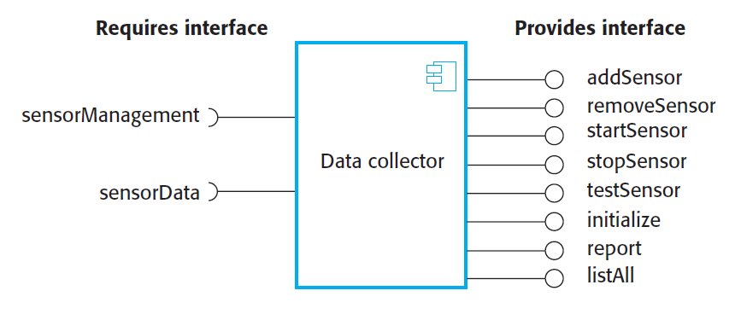
A Component with Interfaces

Slide 41
Information Hiding
Information hiding is distinguished by its guidance for decomposing a system:
Each software unit encapsulates a separate design decision that could be changed in the future
Then the interfaces and interface specifications are used to describe each software unit in terms of its externally visible properties
Using this principle, modules may exhibit different kinds of cohesion
A module that hides a data representation may be informationally cohesive
A module that hides an algorithm may be functionally cohesive
A module that hides the sequence in which tasks are performed may be procedurally cohesive.
A big advantage of information hiding is that the resulting software units are loosely coupled

Slide 42
Incremental Development
Given a design consisting of software units and their interfaces, we can use the information about the units’ dependencies to devise an incremental schedule of development
Start by mapping out the units’ uses relation
relates each software unit to the other software units on which it depends
Uses graphs can help to identify progressively larger subsets of our system that we can implement and test incrementally

Slide 43
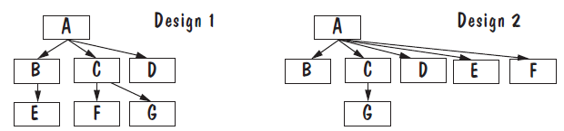
Incremental Development
Nodes represent software units, and directed edges run from the using units, such as A, to the used units, such as B.
Uses graphs for two designs
Fan-out refers to the number of units used by particular software unit
Fan-in refers to the number of units that use a particular software unit
Using Unit
Used Unit

Slide 44
Incremental Development
A uses graph can also help us to identify areas of the design that could be improved
Unit A has a fan-out of three in Design 1 but a fan-out of five in Design 2.
Goal in designing a system is to create software units with high fan-in and low fan-out.
High fan-out usually indicates that the software unit is doing too much and probably ought to be decomposed into smaller, simpler units

Slide 45
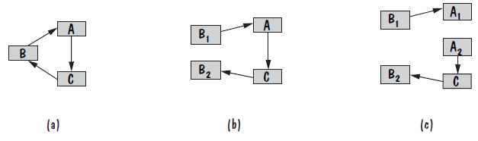
Incremental Development
The cycle in uses graph identifies a collection of units that are mutually dependent on each other.
Cycles are not necessarily bad. If the problem that the units are solving is naturally recursive, then it makes sense for the design to include modules that are mutually recursive.
Large cycles limit the design’s ability to support incremental development: none of the units in the cycle can be developed (i.e., implemented, tested, debugged) until all the cycle’s units are developed

Slide 46
Incremental Development
We can try to break a cycle in the uses graph using a technique called sandwiching
One of the cycle’s units is decomposed into two units, such that one of the new units has no dependencies
Sandwiching can be applied more than once, to break either mutual dependencies in tightly coupled units or long dependency chains

Slide 47
Abstraction
An abstraction is a model or representation that omits some details so that it can focus on other details
The definition is vague about which details are left out of a model, because different abstractions, built for different purposes, omit different kinds of details

Slide 48
Using Abstraction (Sidebar)
Suppose that one of the system’s function is to sort the elements of a list L. The initial description of the design is:
Sort L in ascending order
The next level of abstraction may be a particular algorithm:
DO WHILE I is between 1 and (length of L)–1:
Set LOW to index of smallest value in L(I),..., L(length of L)
Interchange L(I) and L(LOW)
ENDDO
The algorithm provides a great deal of additional information; however, it can be made even more detailed

Slide 49
Using Abstraction (Sidebar)
The third and final algorithm describes exactly how the sorting operation will work:
DO WHILE I is between 1 and (length of L)-1
Set LOW to current value of I
DO WHILE J is between I+1 and (length of L)
IF L(LOW) is greater than L(J)
THEN set LOW to current value of J
ENDIF
ENDDO
Set TEMP to L(LOW)
Set L(LOW) to L(I)
Set L(I) to TEMP
ENDDO

Slide 50
Using Abstraction (Sidebar)
Each level of abstraction serves a purpose.
If we care only about what L looks like before and after sorting, then the first abstraction provides all the information we need.
If we are concerned about the speed of the algorithm, then the second level of abstraction provides sufficient detail to analyze the algorithm’s complexity.
However, if we are writing code for the sorting operation, the third level of abstraction tells us exactly what is to happen; little additional information is needed.

Slide 51
Generality
Make a software unit as universally applicable as possible, to increase the chance that it will be useful in some future system
We make a unit more general by increasing the number of contexts in which it can be used.

Slide 52
Generality
There are several ways of doing this:
Parameterizing context-specific information: We create a more general version of our software by making into parameters the data on which it operates.
Removing preconditions: We remove preconditions by making our software work under conditions that we previously assumed would never happen.
Simplifying postconditions: We reduce postconditions by splitting a complex software unit into multiple units that divide responsibility for providing the postconditions. The units can be used together to solve the original problem, or used separately when only a subset of the postconditions is needed.

Slide 53
Generality
The following four procedure interfaces are listed in order of increasing generality:
PROCEDURE SUM: INTEGER;
POSTCONDITION: returns sum of 3 global variables
PROCEDURE SUM (a, b, c: INTEGER): INTEGER;
POSTCONDITION: returns sum of parameters
PROCEDURE SUM (a[]: INTEGER; len: INTEGER): INTEGER
PRECONDITION: 0 <= len <= size of array a
POSTCONDITION: returns sum of elements 1..len in array a
PROCEDURE SUM (a[]: INTEGER): INTEGER
POSTCONDITION: returns sum of elements in array a
Notes:
The first procedure works only in contexts where global variables have names that match the names used within the procedure body.
The second procedure no longer needs to know the names of the actual variables being summed, but its use is restricted to summing exactly three variables.
The third procedure can sum any number of variables, but the calling code must specify the number of elements to sum.
The last procedure sums all of the elements in its array parameter

Slide 54
References
Shari PFleeger, Joanne Atlee, Software Engineering: Theory and Practice, 4th Edition
Roger S. Pressman, Software Engineering A Practitioner’s Approach, 9th Edition. McGrawHill

